Slide 1


Credit Card Fraud Detection
Credit card fraud is a significant problem, costing businesses and individuals billions of dollars annually. This presentation explores the challenges and techniques involved in detecting credit card fraud using machine learning.

Slide 2

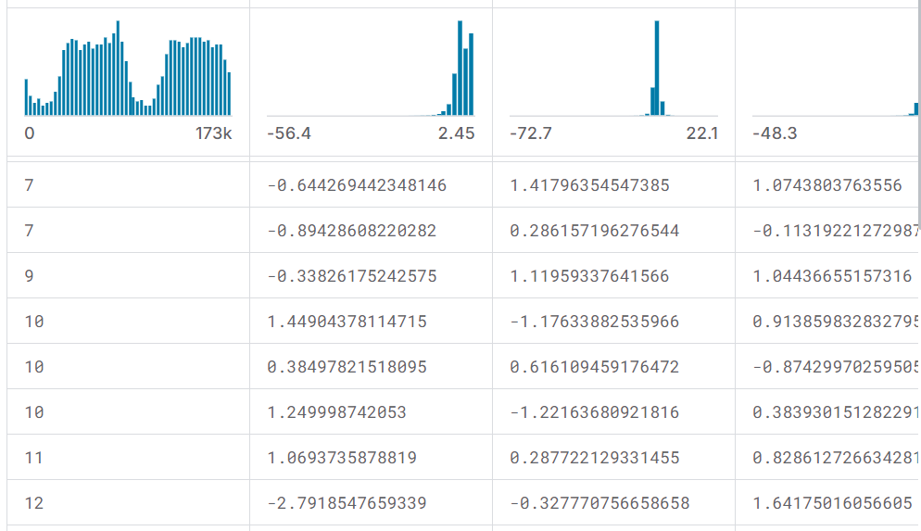
Introduction to the Dataset
1
Origin
2
Features
The dataset contains anonymized credit card transactions from European cardholders.
It includes 28 anonymized features, such as transaction amount, time, and other potentially sensitive variables.
3
Target Variable
4
Imbalance
The 'Class' variable indicates whether a transaction is fraudulent (1) or legitimate (0).
The dataset is highly imbalanced, with a tiny proportion of fraudulent transactions.

Slide 3
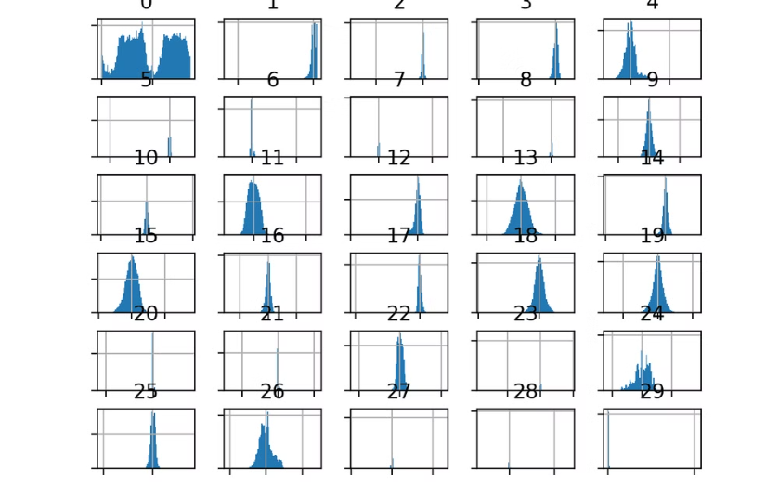
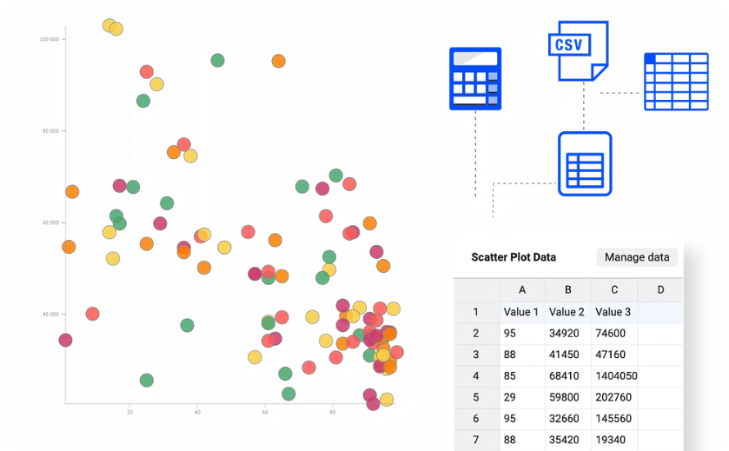
Data Exploration and Visualization
Distribution of Features
Relationships Between Features
Analyzing the distribution of features helps identify potential patterns or anomalies.
Examining relationships between variables can reveal valuable insights about fraudulent transactions.

Slide 4
Feature Engineering and Selection
Feature Engineering
Feature Selection
New features can be created from existing ones to improve model performance.
Selecting relevant features can enhance model efficiency and accuracy.
Principal Component Analysis (PCA)
Recursive Feature Elimination
Time-Based Features
Univariate Feature Selection
Interaction Terms
Feature Importance

Slide 5

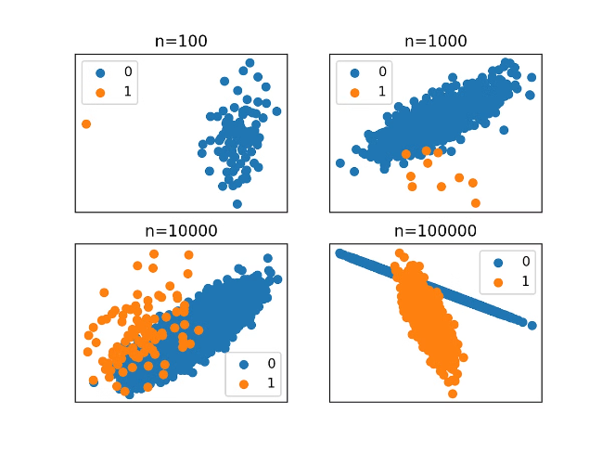
Handling Imbalanced Data
Oversampling
Undersampling
This technique duplicates minority class instances to balance the dataset.
This method removes majority class instances to reduce the imbalance.
Synthetic Minority Over-sampling Technique (SMOTE)
Cost-Sensitive Learning
This approach assigns different costs to misclassifications to prioritize detecting fraudulent transactions.
This technique generates synthetic minority class instances based on existing data.

Slide 6


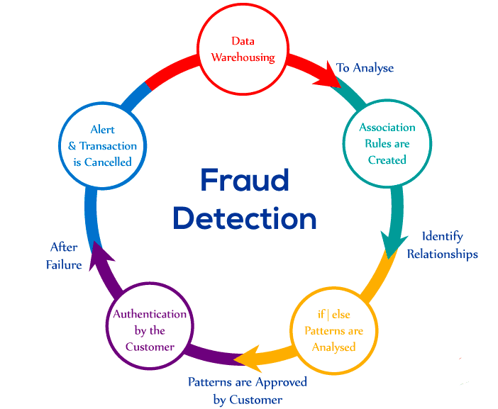



Modeling Techniques
Logistic Regression
A simple and interpretable model for binary classification.
Support Vector Machines (SVMs)
Powerful models that find optimal hyperplanes to separate classes.
Random Forest
Ensemble learning technique combining multiple decision trees for improved accuracy.
Neural Networks
Complex models capable of learning non-linear relationships in data.

Slide 7




Conclusion and Next Steps
Successful Fraud Detection
The chosen model effectively identifies fraudulent transactions with high accuracy and recall.
Continuous Improvement
Regular monitoring and retraining of the model are essential to adapt to evolving fraud patterns.

Slide 8


